Slide 1
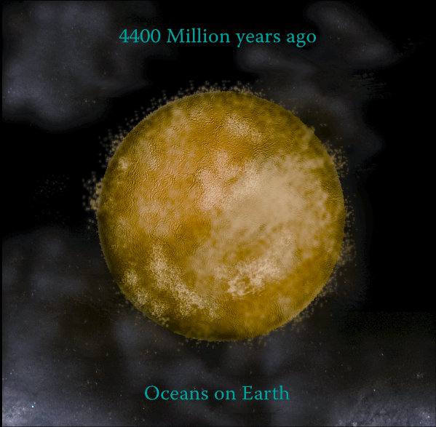
Order from Order: How Life Emerged from a Convection-Driven Submarine Alkaline Vent
Michael Russell
NIS Università degli Studi di Torino
michaeljrussell80@gmail.com
GEE Seminar - UCL
17th November 2021

Slide 2


Galvani bequeathed us: Electrophysiology, Bioelectronics,
Neuromuscular function, Motor nerves → Motors = (Nano)engines
1782 and 1792
ē
Piccolino 2006
Using a Leydon Jar capacitor
Pasteur 1862
Without the idea of spontaneous generation and a physical theory of life, the doctrine of evolution is a mutilated hypothesis without unity or cohesion
1887
No spontaneous generation of organic life
CO₂ atmosphere
“it is the inorganic elements that bring organic chemistry to life” Garner 1994
Beware of vitalism under new guises: e.g., organic soup, RNA World……
Life transcends chemistry! (Nick Lane)
Where is the wisdom we have lost in knowledge? Where is the knowledge we have lost in information?

Slide 3
& how this planetary process interfaces with aqueous electro-chemistry
Life is NOT one pot mass action,
chemical catalysis
Galvani, L. 1791 Bologna: Tip. Istituto delle Scienze.
Lane, N. 2010 Nature Ed 3:18.
Ducluzeau et al. 2014, BBA Bioenerg 1837, 982
Duval et al. 2019 Interface focus, 9
Branscomb, Russell, 2019 Interface focus, 9
Russell et al. 2021 Life 11, 429

Slide 4

IMAGINE the initial conditions
Hard UV
Lightning
Impactors
THERE WAS NO LAND 4.4Ga
when life onset
Just a turbulent torrential water world
whirling at > twice its present rate
The
looming
Moon!
Russell et al. 2014 Astrobiology 14, 308
Bartlett, Stevenson 2016 Geophys Res Lett 43, 5716
Monteux et al. 2020 Geophys J Internl 221, 1165
BUT NB. Monteux questioned by Korenaga 2021 Life 11, 1142

Slide 5
NO PART OF THE HADEAN CRUST BROKE THE OCEAN SURFACE
Saline & carbonic, silicic
Hadean Ocean + metal ions
EoL
410℃
100℃
Thick partially serpentinized crust
CO₂
Partially molten “mushy”
convecting Upper Mantle
Note ordered hydrothermal convection cells but no chimneys at 410℃
Russell 2021 The "Water Problem"(sic), the Illusory Pond and Life’s Submarine Emergence. Life 11, 429
Monteux et al. 2020 A Mushy Earth’s Mantle for more than 500 Myr. Geophys J Internatl 221, 1165
But see Korenaga 2021 Life 11, 1142

Slide 6
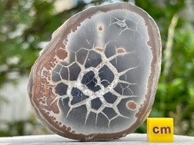
THERE WAS NO “WATER PROBLEM” IN THE DEPTHS OF THE HADEAN OCEAN!
e.g., Amorphous silica to chert and,
Dewatering cracks in the Marine Dalradian (late Proterozoic), Islay, W Scotland. Tanner 1998
and see
White, W.A. (1961) Colloid phenomena in the sedimentation of argillaceous rocks. J. Sedim. Petrol., 31, 560-570.
Tanner, P. W. G. (1998). Interstratal dewatering origin for polygonal patterns of sand-filled cracks: a case study from late Proterozoic metasediments of Islay, Scotland. Sedimentology, 45, 71-89.
McMahon, S., van Smeerdijk Hood, A., & McIlroy, D. (2017). The origin and occurrence of subaqueous sedimentary cracks. Geological Society, London, Special Publications, 448, 285-309.
Cf.
septarian
nodule

Slide 7
THERE WAS NO “WATER PROBLEM” IN THE DEPTHS OF THE HADEAN OCEAN!
e.g., Synerectic aging of silica gel → ~FeOOH Liesegang rings
Elliston, J. 2018 Hydration of Silica and Its Role in the Formation of Quartz Veins – Part 1. Substantia 2, 43-71.

Slide 8
NOx
CO₂ NOx CO₂
Ocean
Fougerite
EoL
CO₂
Mackinawite
CO₂
BIF
~50 mPa
CH₄
Serpentinization
Pyrrhotite
Crust, Olivine
~1.5 GPa
Upper mantle, Olivine
CO₂
CO₂
~23 GPa
CO₂
CO₂
Fe⁰
CO₂
Lower mantle, Bridgmanite
H₂
H₂
~136 GPa
Outer core, Iron
Russell, Ponce Life 2020, 10, 291

Slide 9
Submarine CO₂ bubbling up from magma at depth produces low pH seawater along a volcanic coast in the Phillipines
Cardenas et al. 2019. Geophys Res Lett GL085730.

Slide 10
Conditions for the
Emergence of Life
YOUNG SUN
Rain-out from
Hadean atmosphere
N₂+CO₂→NO
CO₂ >> N₂ > H₂O > SO₄ > CO > NO > P₄O₁₀ > S₈ > H₂S > H₂
Fe^{III} Mn^{IV}
NO₃– + NO₂–
ē
ē
DISEQUILIBRIA
ē
ē
ē
WASTE
H₃O⁺
𝝙pH ~ 5
2D Fougerite >
2D Greeanlite?>
2D Mackinawite
H₂
CH₄
⬇︎
410℃ springs + volcanic vapours
Fe²⁺ Mn²⁺ Zn²⁺ Ni²⁺ Co²⁺ P₄O₁₀
OH–
CARBONIC
OCEAN
EoL
70-40℃
HS–
Mo^{IV}
Green Rust/greenalite,precursors to Banded Iron Formation
Alkaline vent
~130℃
CO₂ >> N₂ > H₂O > SO₄ > CO > NO > P₄O₁₀ > S₈ > H₂S > H₂
Serpentinizing crust
Magmatic devolatilization
⬇︎
Song H, Ou X, Han B, Deng H, Zhang W, Tian C, Cai C, Lu A, Lin Z, Chai L 2021 Ni²⁺ boosting H₂O reduction by Fe(OH)₂ oxidation during low‐temperature serpentinization. Angew. Chem. Int. Ed. 6045, 24054-24058.
⬆︎⬆︎ ⬆︎

Slide 11
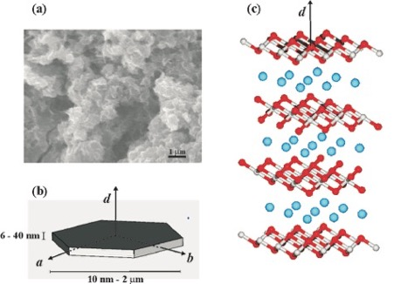
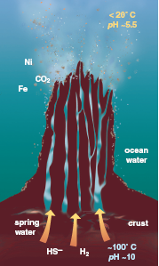
2D complex green rust mineral ~Fe₂(OH)₅.H₂O
Submarine alkaline springs then and now
4.4 Ga alkaline hydrothermal vent “hatchery of life”
Russell et al 1989, 2003
Lost City alkaline vent Kelley et al.
2001 & see Russell et al 1989
Beehive
diffuser
CO₂
anions
ocean
Water
2D subsidiary Mackinawite FeS
crust
brucite
Mg(OH)₂
HS
H₂
~100ºC
pH ~10
Greenalite
Fe₂^{2+/3+}.3Si₂O₅(OH)₄
Lost City science party
Jochym et al. 2010. J. Phys: Cond. Matter 22 445403; Duval et al. 2019. Interface Focus. 20190063; White et al. 2015. Earth Planet Sci. Lett. 430, 105; Rasmussen et al. 2021 Astrobiology 21, 246

Slide 12
Ni²⁺ Boosting H₂O Reduction by Fe(OH)₂ Oxidation during Low-Temperature Serpentinization
Song et al. 2021
Origin of
hydrothermal H2
Water adsorption
Transition state
Dissociation
Song H, Ou X, Han B, Deng H, Zhang W, Tian C, Cai C, Lu A, Lin Z, Chai L 2021 Ni²⁺ boosting H₂O reduction by Fe(OH)₂ oxidation during low‐temperature serpentinization. Angew. Chem. Int. Ed. 6045, 24054-24058.

Slide 13
Green rust: THE ALREADY-COMPLEX PRECURSOR OF THE CELL?
Fe³⁺
0.3–0.4nm
gallery
CO₃⁼/Cl⁻, NO₃⁻, SO₄⁼, PO₄³⁻, H₂O
0.79 nm
Fe²⁺
(Mg, Ni, Co)
Fe²⁺₄Fe³⁺₂(OH)₁₂CO₃.3H₂O ⇔ Fe²⁺₂Fe³⁺₄(OH)₁₀CO₃.3H₂O + H₂ + 2ē
Fougerite (green rust) is a “soft” 2D-anionic clay hosting ionic substitutes, & capable
of conformational change in response to its “hard” solid electrolyte properties
& can mediate gradient-driven coupling mechanisms in confined viscous hydrous 2D spaces
Arrhenius et al. 1997 J Theor Biol 187, 503; Génin et al. 2006 Solid State Sci 8, 1330; Etique et al. 2016 Geobiology, 14, 237-254; Russell 2018 Life 8, 35;
Duval et al. 2019 Interface Focus 20190063; Sun et al. 2021 Geochem. Trans. 22, 1-10

Slide 14
Green rust, a heterogeneous 2D-Double Layer Iron Oxyhydroxide
200 nm
Mass precipitation of green rust
Fe II–III hydroxy-carbonate
Génin et al. 2005 Solid State Sci 7:545
Note, the confined water in the GR
interlayers, i.e., no “water problem”!

Slide 15
ENGINE 1: HYPOTHETICAL HYDROGENATION OF CO₂ TO FORMATE
…
…
inputs
.H₂O
4+
output
“membrane”
Ni²⁺
inputs
Branscomb, Russell 2013; Vasiliadou et al. 2019; Then see Hudson et al. 2020 PNAS 117, 22873

Slide 16
CO₂ reduction to formate by H₂ and H⁺
via vectorial electrochemistry in a microfluidic reactor
pH6
pH6 →
FeS BARRIER 70 μm thick
H⁺ fast
~25nm
pH11
pH11 →
300 minutes
X6
Vasiliadou et al. 2019*** Interface Focus 9:2019 0063
H⁺ flux is 2X10⁶ faster than OH⁻ flux
Sojo et al. 2014 PLoS Biol. 12
Hudson et al. 2020, PNAS 117, 22873-22879,

Slide 17
CO₂ reduction driven by a pH gradient
Hudson et al. 2020, PNAS 117, 22873-22879
Entrainment
and venturi
effect
FeS BARRIER 70 μm thick
~25nm
Mielke et al. 2011
Astrobio
300 minutes
X6
Beehive diffuser
Lost City
pH12.6 →
←pH3.9
Wheeler et al. 2013 Moytirra.
Geochem/phys/syst. 14.10 4170

Slide 18
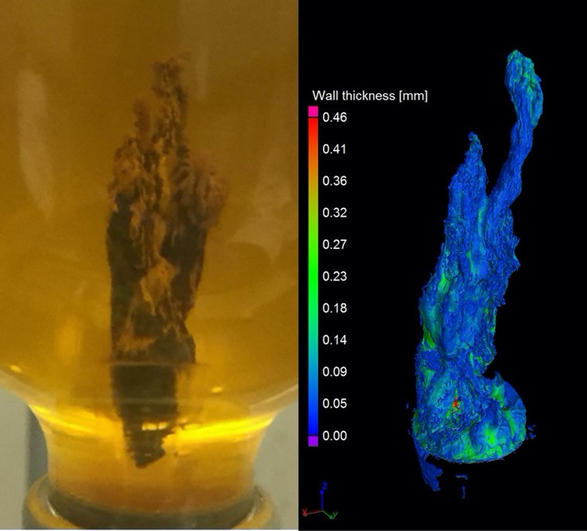
Laboratory grown green rust (fougerite) chimneys
2D-Fe₂(OH)₅.H₂O
wall 10-40 µm thick
comprising ~50 – 200 complex ~ 200 nm
nanocrysts orthogonal with wall
Barge et al. 2020, 3D-analysis of simulated prebiotic hydrothermal chimney. ACS Earth Space Chem. 4.9, 1663

Slide 19
Systems produce the billions electrons/sec required by life
Submarine power-plant
…
Yamamoto et al. 2013 Generation of Electricity and Illumination by an Environmental Fuel Cell in Deep‐Sea Hydrothermal Vents. 52: 10758
Barge et al. 2015 Angew Chem Int Ed 54:8184

Slide 20
GREEN RUST ELECTROLYTE and disequilibria “burner”
2nd Phase in
Life’s Emergence
ACIDULOUS
CARBONC
OCEAN
ALKALINE
HYDROTHERMAL
FLUX
cf. “PALAEO-LABLET” (McCaskill et al. 2012)
i.e., Chemically Reactive Micro-Electronic Agent
H⁺/OH⁻
H⁺/OH⁻
H⁺/OH⁻
ē
ē
ē
ē
← ē ē
NO₃⁻ counter anions Cl⁻ CO₃⁼ SO₄⁼
H⁺/OH⁻
H⁺/OH⁻
ē
ē
← ē ē
ē
ē
H⁺/OH⁻
H⁺/OH⁻
H⁺/OH⁻
Complexity begets complexity
H⁺/OH⁻
H⁺/OH⁻
H⁺/OH⁻
← ē ē
H⁺/OH⁻
H⁺/OH⁻
←
H⁺/OH⁻
H⁺/OH⁻
H⁺/OH⁻
CO₂
H⁺ →
← ē ē
H⁺/OH⁻
OH⁻
OH⁻
NO₃⁻
H⁺ →
Duval et al. 2019. Interf. Focus 9
Branscomb, Russell 2019
Interface focus, 9
Russell 2018 Life 8, 35
_{OH}⁻
H₂
OH⁻
_{OH}⁻
H₂
OH⁻
CH₄
GR BARRIER
OH⁻
OH⁻
OH⁻

Slide 21

Nitrate to ammonia, and hydrazine?
,
H⁺ →
H⁺/OH⁻
ē
ē
ē
ē
← ē ē
2H⁺
H⁺
2H⁺
2H⁺
H⁺
H⁺/OH⁻
2H⁺ + NO₃⁻
NO₂⁻
NO
HNO
H₂NOH
N₂H₄
NH₂⁻
NH₃
ē
ē
ē
ē
← ē ē
CO₂
Electrostatic/conformational Gate
controls ‘escape’ment mechanism
H⁺/OH⁻
NO₃⁻
100℃
H⁺ →
Binding pocket
Charge-trapped anions
‘escape’ inward only on reduction, hydrogenation
or condensation, driven by concentration gradients
H⁺/OH⁻
H⁺ →
_{OH}⁻
H₂
Hansen et al 2001 Appl Clay Sci. 218, 81; Branscomb et al. 2017 Phys. Rep. 677, 1–60; Wong et al. 2017 Astrobiology 17, 975; Russell 2018 Green Rust. Life, 8, 35; Duval et al. 2019 Interface Focus 9
OCEAN
CH₄
GR BARRIER

Slide 22
“proton gradients enable cellular metabolism to transcend chemistry” Lane
H⁺ →
flux-force linear conversions, i.e., where the flux ∝ thermodynamic force
H⁺/OH⁻
ē
ē
ē
ē
← ē ē
2H⁺
H⁺
2H⁺
2H⁺
H⁺
H⁺/OH⁻
2H⁺ + NO₃⁻
NO₂⁻
NO
HNO
H₂NOH
NH₃
NH₂⁻
ē
ē
ē
ē
← ē ē
CO₂
peristaltic GR layers govern an interlayer regime where water is so viscous that the thermodynamic force imposes a linear proportionality to flux as in enzymes
H⁺/OH⁻
NO₃⁻
100℃
H⁺ →
H⁺/OH⁻
Branscomb, Russell 2019 Interface focus, 9;
Astumian 2007 Phys. Chem. Chem. Phys. 9, 5067–5083.
Lane 2010 Nature Education 3, 2.
Hansen et al. 2001 Appl. Clay Sci. 218, 81–91.
Stucki 1980 Eur. J. Biochem. 109, 269–283.
Onsager 1931 Phys. Rev. 37, 405–426.
H⁺ →
_{OH}⁻
H₂
OCEAN
CH₄

Slide 23
green rust AS READY-MADE COMPARTMENTALIZED NANOengine
H⁺ →
Nucleobases Flavins NAD(P)
H⁺/OH⁻
ē
ē
ē
ē
← ē ē
2H⁺
H⁺
2H⁺
2H⁺
H⁺
H⁺/OH⁻
2H⁺ + NO₃⁻
NO₂⁻
NO
HNO
H₂NOH
N₂H₄
NH₂⁻
NH₃
ē
ē
ē
ē
← ē ē
CO₂
Gallery ~0.3nm
Bilateral bonding
H⁺/OH⁻
NO₃⁻
H⁺ →
H⁺ → NH₃ → NH₄⁺ + C₃H₄O₃⁻ → C₃H₆O₂NH₂ → [C₃H₅O₂NH₂]_{n}?
_{OH}⁻
H₂
H⁺ →
CH₄
Alanine
OCEAN
Barge, Flores, Baum, VanderVelde, Russell 2019 PNAS 116:4828
Duval et al. 2019. Interface Focus. 20190063.

Slide 24
AMINATION OF PYRUVATE TO ALANINE IN GREEN RUST
C₃H₃O₃⁻
C₃H₇NO₂
C₃H₆O₃⁻
Barge, Flores, Baum
VanderVelde, Russell
PNAS 116:4828
Glyoxalate → Glycine
HC₂O₃⁻ C₂H₅NO₂
Barge et al. 2020
JGR Planets, 125
e2020JE006423
Fe(II) %

Slide 25
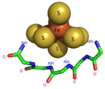
PROTOMETABOLIST TO ORGANC TAKEOVER?
ē
ē
ē
ē
← ē ē
2H⁺
H⁺
2H⁺
2H⁺
H⁺
H⁺/OH⁻
2H⁺ + NO₃⁻
NO₂⁻
NO
HNO
H₂NOH
NH₂
NH₃
H⁺/OH⁻
ē
ē
ē
ē
← ē ē
H⁺/OH⁻
CH₄ + NO + 2e⁻ + 2H⁺ → CH₃OH + NH₂
H⁺/OH⁻
←
H⁺/OH⁻
CO₂
H⁺ →
H⁺ → NH₃ → NH₄⁺ + C₃H₄O₃⁻ → C₃H₆O₂NH₂ → [C₃H₅O₂NH₂]_{n}
H⁺/OH⁻
← ē ē
OH⁻
H⁺ →
polyalanine
_{OH}⁻
H₂
OH⁻
OCEAN
CH₄
NO₃
OH⁻
OH⁻
Nitschke et al. 2013 Antiquity of metalloenzymes BBA-Bioenergetics, 1827, 871-881.
Branscomb, Russell 2019 On the beneficent thickness of water. Interface focus, 9
Milner-White 2019 Protein three-dimensional structures at ‘OoL’. Interface focus, 9, 0057
Jordan et al. 2021 assembly of redox-active Fe-S clusters at low conc^{tn} of cys. Nature comm 12, 1

Slide 26
ATPase is too complicated to produce the pyrophosphate bond,
but a pyrophosphatase (Pi→Ppi) is much simpler
“inside”
……………………
“outside”
Something simpler than ATPase is needed at origin of life

Slide 27
Simpler membrane pyrophosphatase pumps can also produce PPi, the energy currency of the cell
P-loop
Bianchi et al. 2012
P-loop nest binds inorganic phosphate
Proteins 80:1418
Natural P-loop
Milner-White, Russell, 2011 Peptide era & emergence of life Genes 2, 671-688
Li et al., 2016
Membrane pyrophosphatases
Nature communications, 7, 13596.

Slide 28
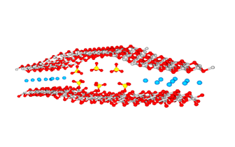
Ferric green rust as speculative H⁺-pyrophosphatase
Russell, Nitschke, Branscomb, 2013, The inevitable journey to being.
Phil. Trans. R. Soc. Lond. B. Biol. Sci., 368, 20120254.
Fe³⁺
H₂
HPi²⁻
H⁺
green rust barrier
OH⁻
RSR’
H⁺
NO₃⁻
OH⁻
NO₃⁻
H⁺
H₂
H⁺ + HPi²⁻ + HPi²⁻
H⁺ + HPPi³⁻
HPPi³⁻ → phosphorylations
H⁺
H⁺
Fe³⁺ polaron propagation
+ H₂O
RSR’
NO₃⁻
H⁺
H⁺
CH₄
Fe²⁺
H⁺
NO₃⁻
CH₄
OH⁻
OH⁻
H⁺ + HPPi³⁻
RSR’
H₂
Acidulous
Hadean
Ocean
exterior
Alkaline
hydrothermal
interior
polaron dilation
Duval et al. 2019. Interface Focus, 20190063.
Branscomb & Russell. 2019.
On the beneficent thickness of water
Interface Focus, 9, 20190061.

Slide 29
Microfluidic Production of Pyrophosphate Catalyzed by Mineral Membranes with Steep pH Gradients
Qingpu Wang, Laura M. Barge, Oliver Steinbock,
2019, Chemistry–A European Journal 25: 4732
HPO₄²⁻ + CH₃COPO₄²⁻ + H⁺ ⇔ HP₂O₇³⁻ + CH₃COOH
but Whicher et al. 2018 OLEB 48, 159:show production of acetyl phosphate – a phosphorylating agent – from thioacetate in water!

Slide 30
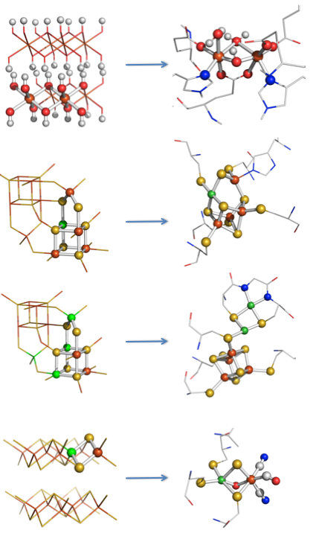
Structure of Green Rust and Methane Monooxygenase active site
nickel
iron
nitrogen
oxygen
hydrogen
sulfur

Slide 31


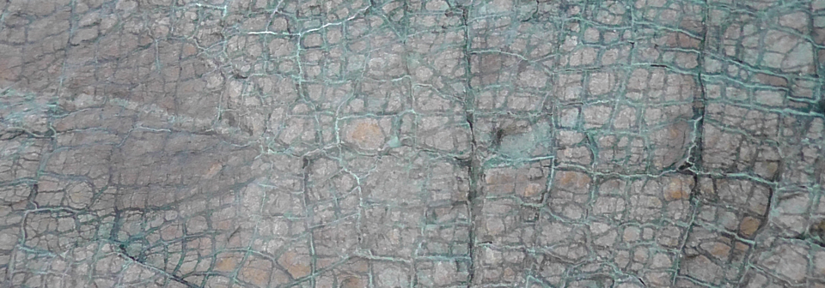
The denitrifying methanotrophic acetogenic pathway
Nitschke, Russell 2013
Phil. Trans. R. Soc. Lond.
B. 368, 20120
CH₃COO⁻
NO
Carbonic ocean
pH ~5.5
Hydrothermal mound
BIOSYNTHESIS
CH₃COSCH₃
H⁺
CO
•CH₃
Carbureted oxidation
CO₂
NO⁻₂
~100°C
pH ~10.5
OCEAN
FLOOR
SERPENTINIZED
ULTRAMAFICS
H₂
H₂
CH₄

Slide 32
Gain of function during the emergence of life through complexification
driven by incremental increases in stochastic entropy production
First common ancestor(s)
↑Missing
↑Links !?
Entrainment of virome
into protometabolism?
RNA-amino acid affinities
2D-GR acts as an autonomic
homeostat & guidance system
4th tasks
GR produces peptides? +
heterocycles→organic takeover
3rd tasks
Evolution governed
by the law of
natural rejection
”inscape” to deep biosphere→
GR acts as nanoengine
driving protometabolism
by redox and pH gradients
2nd tasks
Precipitation of green rust
>>FeS barriers/membranes
1st “tasks”
H₂
~100°C
OH⁻
H₂
CH₄

Slide 33
Summary cartoon: green rust interlayers resolving disequilibria at the vent & trapping the prebiotic product
WASTE
Rechargable GR has Functional Sequence Complexity with potential as multi-‘purpose’ transistors and computing nanoengines
[cf. Trixler, 2021].
Order creation =
emerging metabolism
GR
Disequilibria at the vent/
‘entropy disproportionation’
Branscomb, Russell 2019 On the beneficent thickness of water. Interface focus, 9
Russell 2018 Green rust: The simple organizing ‘seed’ of all life? Life, 8, 35
Duval et al. 2019 Fougerite: The not so simple progenitor of the first cells. Interface focus, 9

Slide 34







Collaborators – with appreciation!
Wolfgang Nitschke
Elbert Branscomb
Simon Duval
Orion Farr
Kilian Zuchan
Julyan
Cartwright
Alessandro Minguzzi
Alberto
Vertova
Francesco
Panico
Sara
Pellegrino
James
Milner-White
Adrian
Ponce

